Slide 1


Research Experience and Software Engineering
Kai Armstrong
KaiArmstrong322@gmail.com KArmstrong@lincoln.ac.uk
(+44)7720863979

Slide 2
Structure
Introduction
Software Development (Research Purposes)
Machine Learning Research
Blue-Sky-Thinking
Why Me

Slide 3
About Me
BSc (hons) Biochemistry - University of Lincoln
Proteomic Analysis of HSP90 - Supervisor: Dr Stephan Millson
MSc (taught) Bioinformatics - Newcastle University
Prediction of Osteoarthritis Incidence using Machine Learning - Supervisor Prof Jaume Bacardit
PhD Computer Science - University of Lincoln
Quantification of Human Motion using Deep Learning for Biomarker Identification and Automated Rehabilitation Assessments - Supervisor: Dr Lei Zhang, Prof Xujing Ye, Prof Paul Lee

Slide 4
Proteomics Command Line Tool
UniProt
Access via API
Search for similar proteins (by function)
Output FASTA file of sequences
Multiple Sequence Alignment
Alignment via MAFFT
Usage of MAFFT Python wrapper (in Biopython)
Alter strategy in command line arguments
Phylogenetic Tree
MAFFT provided tree
Analysis using Biopython Phylo
Output as svg or html

Slide 5
Healthcare Human Pose Estimation
Record Video
OpenCV-Python with ffmpeg
Record and save videos as .mp4
Access frame rate and resolution of camera
Process Video
Human Pose Estimation or Human Mesh Recovery
Isolate people - Perform for each person (bounding box)
Custom-built biomechanics processing toolkit
Visualise Biomechanics
Online Interactive Dashboard (streamlit, plotly)
Signal Processing (breakpoints, interpolation, etc)
Print as pdf or save as html

Slide 6
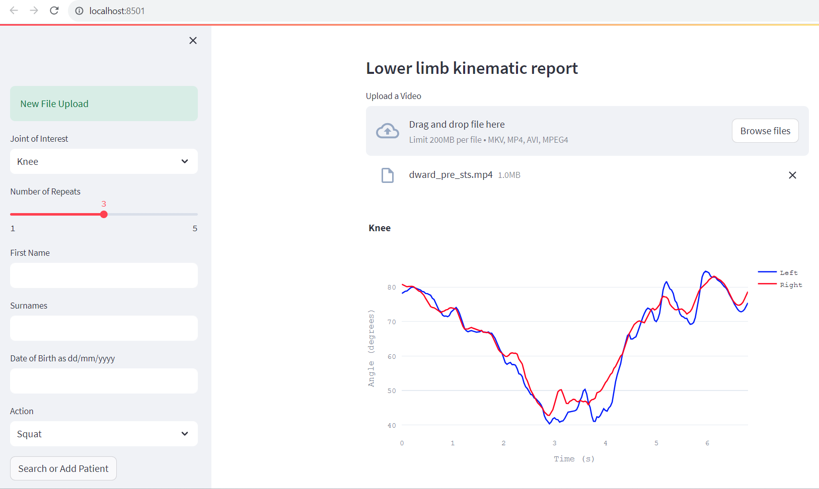

Slide 7
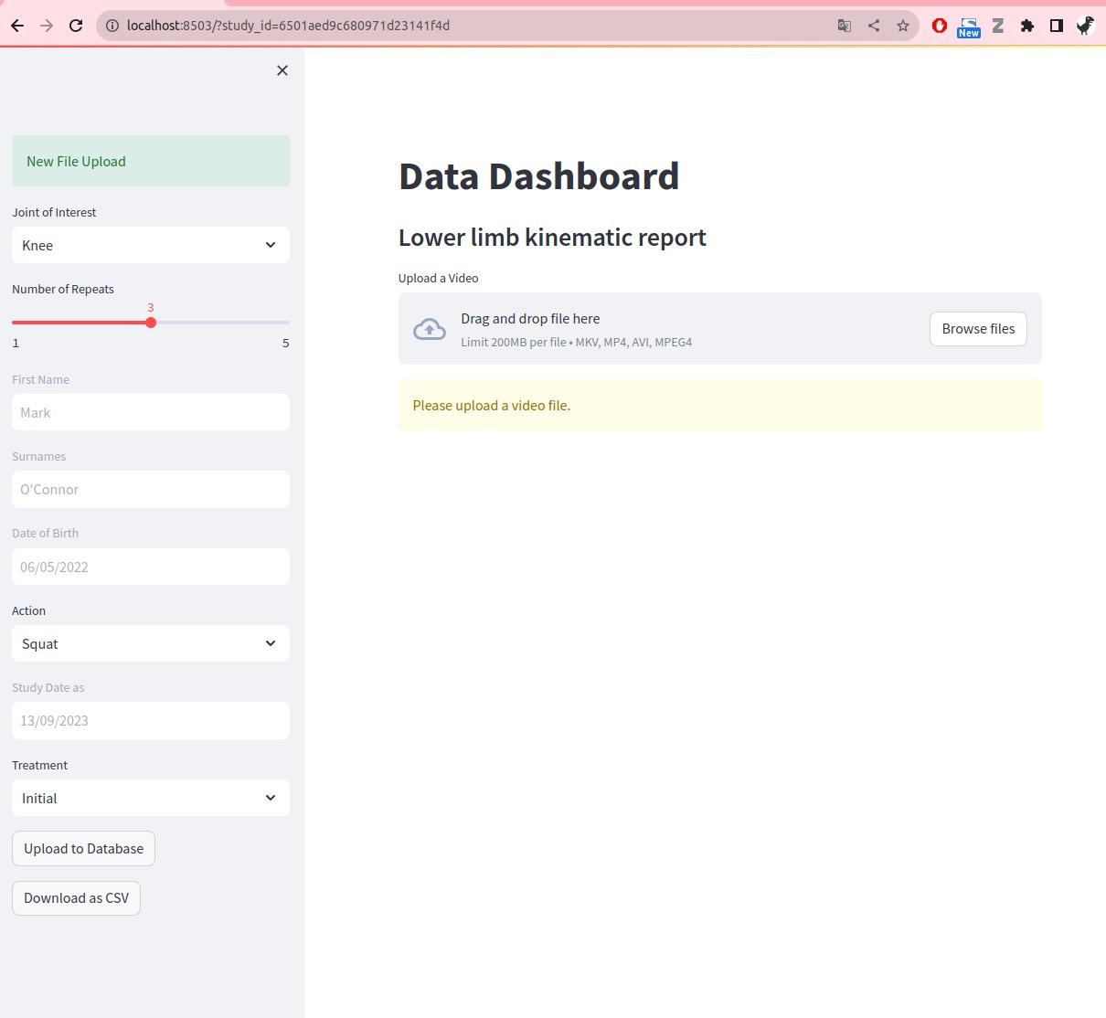

Slide 8
Medical Action Recognition
Videos processed using Human Pose Estimation
Extract biomechanics and joint movement
Dimensionality reduction and statistical analyses
Manual Feature Extraction
ML Pipeline
Data normalisation/scaling
Classification (Random Forest/XGBoost)
Hyper Parameter Optimisation
Feature Importance
Recursive Feature Elimination
SHapley Additive exPlanations (SHAP)
Explainable AI

Slide 9
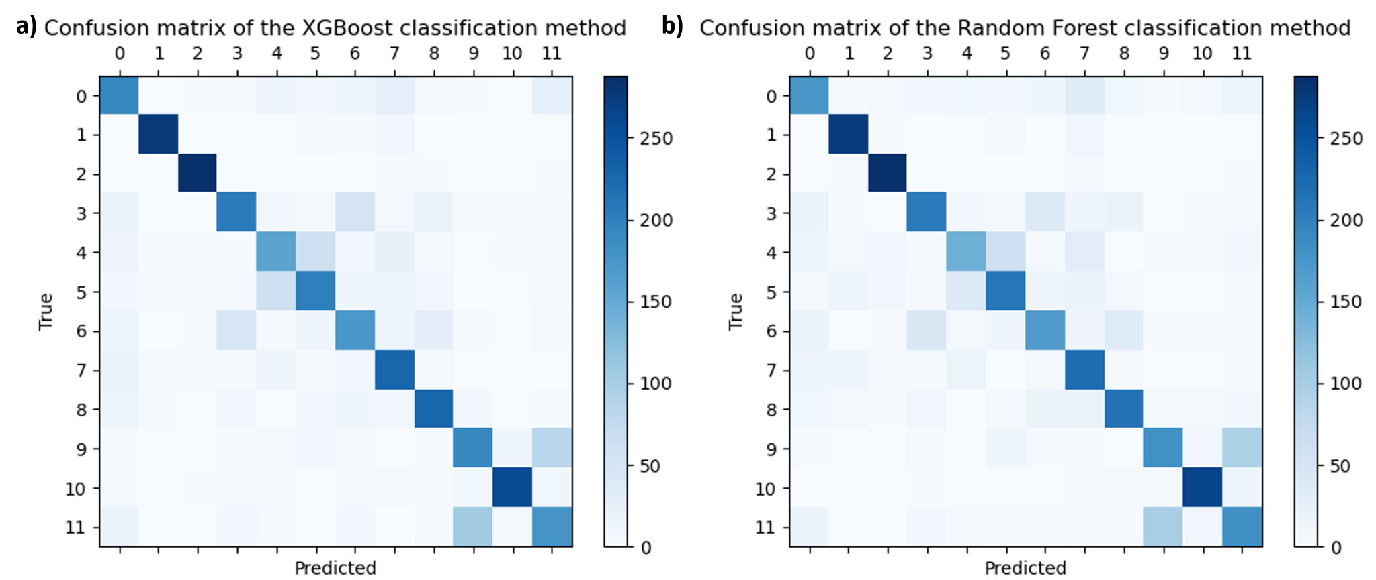

Slide 10
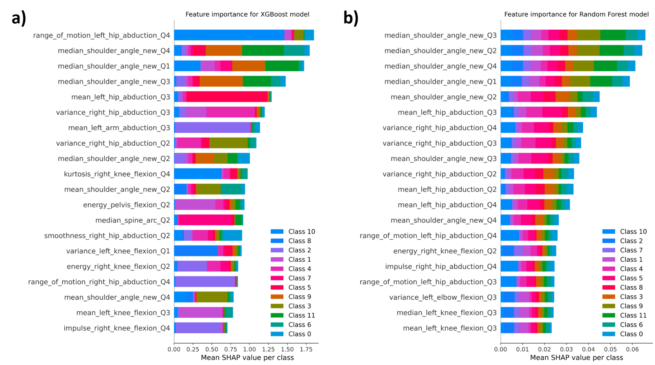

Slide 11
Approach to DNA/RNA Nanotechnology Workflow
Integrate well-known workflows such as oxDNA and cadnano using data conversion scripts
Create one consistent data format with the tools to generate data
Save time and resources by integrating more checks to the input data
Check input format and sequence
Standardised testing and debugging
Dedicated support and continuous improvements (often lacking in academic tools)
More integration with tools such as oxDNA, cadnano, and DAEDALUS (testing)
Scalable service using GPU architectures - cloud-based solution

Slide 12
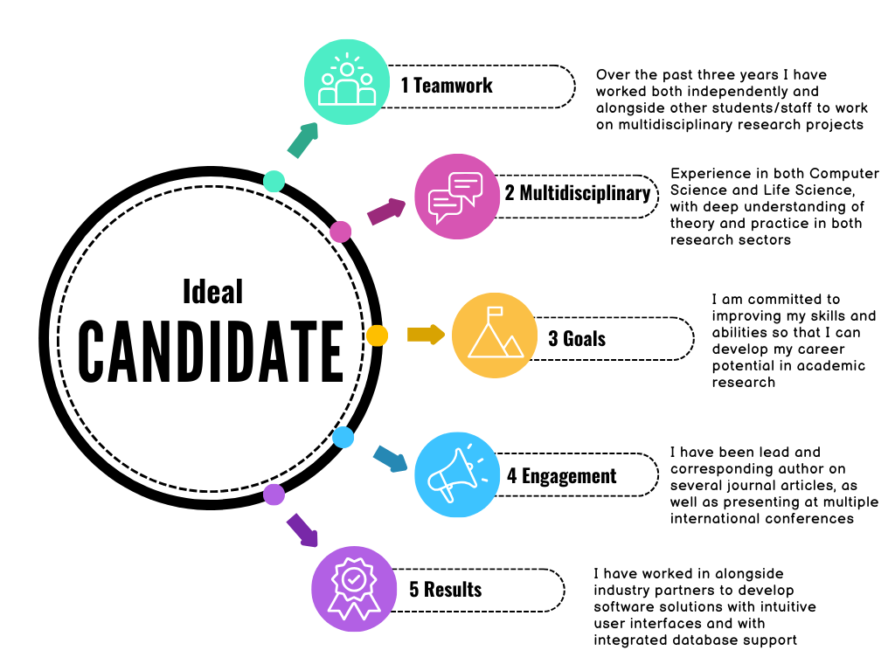
Why Me?

